Slide 1
Electrical Charge Equations

Slide 2
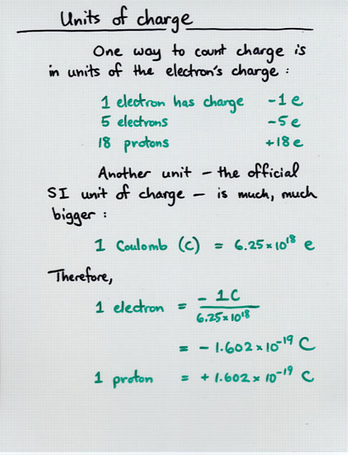
Electrons (Smallest Charge)
Electrons e⁻ are:
The smallest unit of charge
Moving electrons produce
Electricity
Light & Radio Waves
One electron is extremely weak
You need a huge amount to do anything!
Protons p⁺ are:
The opposite of electron charge
Don’t usually move much

Slide 3
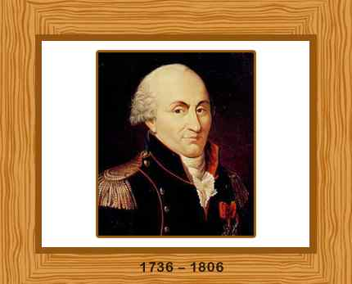
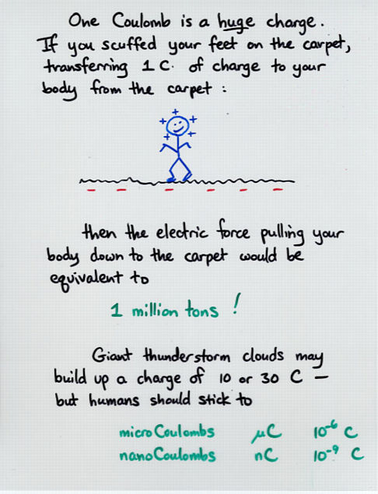
Coulomb (Units of Charge)
The Coulomb is
The Metric Unit for Electric Charge
Its equation symbol is: "q"
Its unit symbol is: "C"
1 C = 6.24x10¹⁸ electrons (or protons)
or 1 electron = 1.60x10⁻¹⁹ C
It is named after:
Charles Augustin de Coulomb
A French Physist
Studied electricity in the 1770's

Slide 4
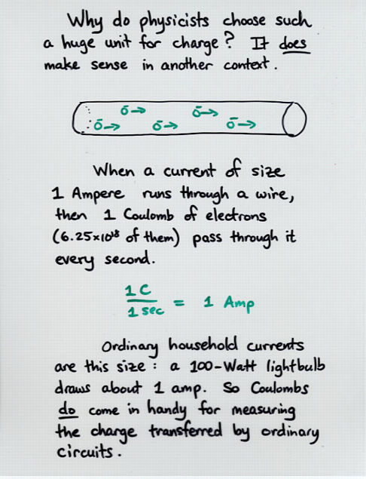
Electric Current (I)
Electric Current is:
The rate of flow of electrons
I = q / Δt
Therefore, Amperes (A) are:
Coulombs per second
1 A = 1 C/s

Slide 5
Electric Current (I)
In a 10 A circuit, how many coulombs of charge flow through a light bulb in 1 minute?
I = q / Δt or q = I x Δt
q = 10 A x 60 s
q = 10 C/s x 60 s
q = 600 C

Slide 6
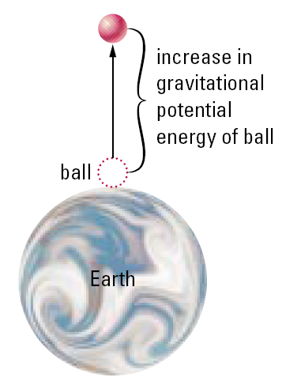
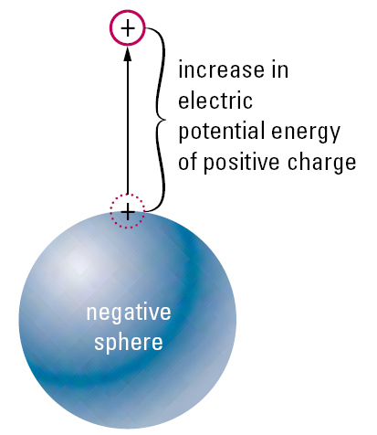
Electric Potential Difference (V)
Electric potential is a measurement of:
the electric potential energy of the electrons.
V = ΔE / q
It measures both:
ΔE – The energy of electrons (where ΔE is measured in Joules "J")
q – The number of electrons
Electric potential is measured in Volts (V)
1 V = 1 J/C

Slide 7
Electric Potential Difference (V)
10 C of electrons has 1200 J of energy. What is their electric potential?
V = ΔE / q
V = 1200 J / 10 C
V = 120 J/C
V = 120 Volts

Slide 8
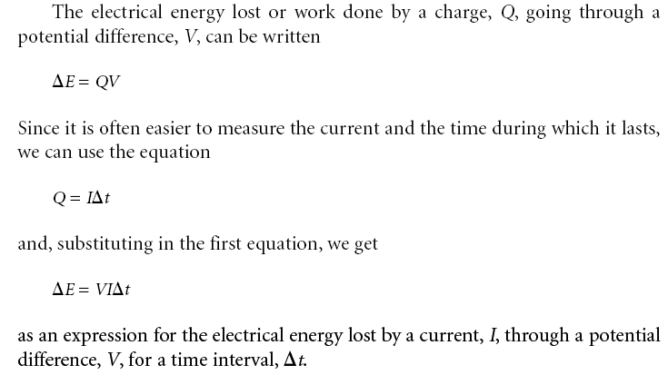
Electric Energy (ΔE)
Electrical appliances use energy
ΔE is the energy used (measured in Joules "J")
ΔE = VIΔt

Slide 9
Practice Questions

Slide 10
Electrical Charge Equation Notes:
In physics, q is measured in ___________
1C = ___________ electrons
1 electron = ____________ Coulombs
Electric Current Equation: I = ________
Amperes: 1A = __________
Potential Difference Equation: V = _________
Volts: 1V = ____________
In physics, ΔE is measured in ___________
Electrical Energy Equation: ΔE = _________

Slide 11
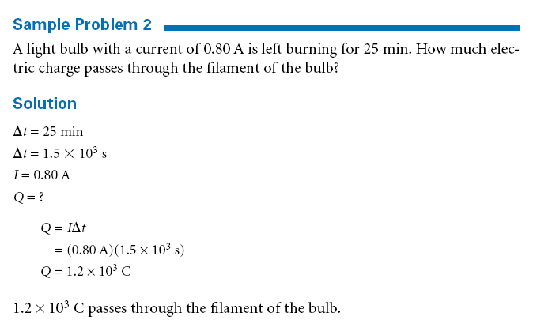

Slide 12
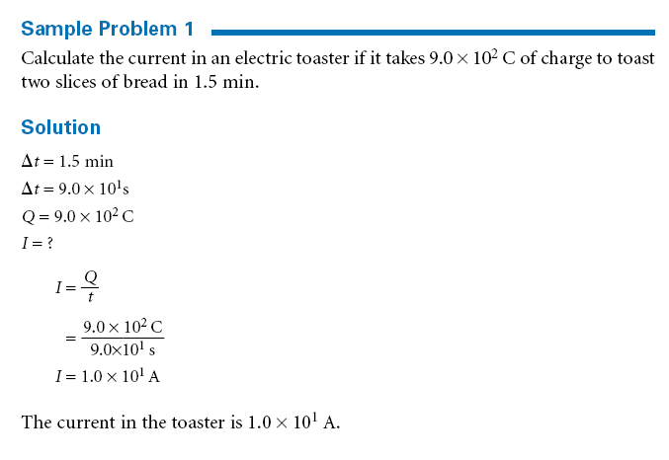

Slide 13
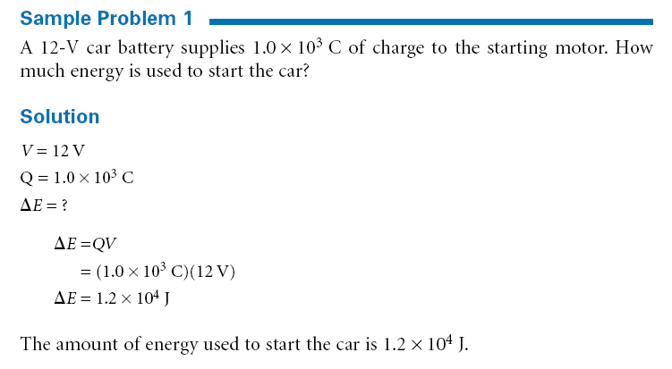
Electric Potential Difference

Slide 14
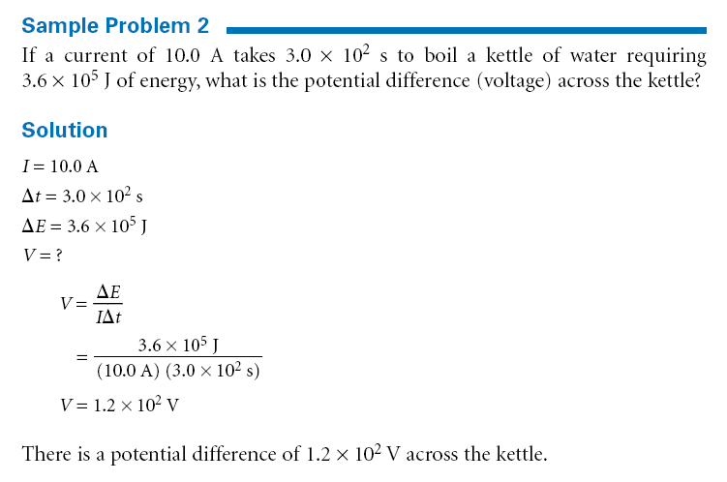
Electric Potential Difference

Slide 15
